Slide 1
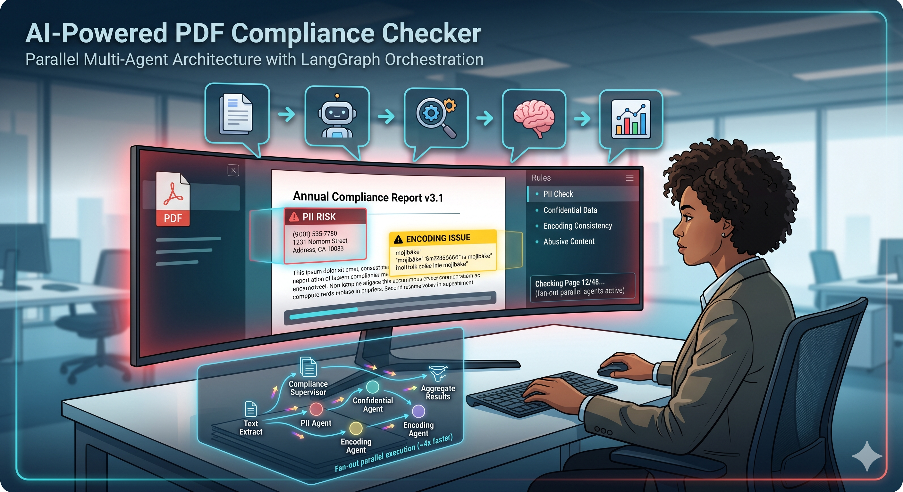


AI-Powered PDF
Compliance Checker
Presented by Team 6
Team Members
Rekha Kumre
Avranil Set
Md Wasim
Bhupesh Bora

Slide 2
The Problem We're Solving
Manual Review Problems
•
Slow, page-by-page human inspection
•
Inconsistent application of rules
•
No digital audit trail or reasoning
•
High risk of missing sensitive PII

Slide 3
Our Solution
Multi-Agent AI Compliance Pipeline
Core Architecture
Parallel AI compliance agents
LangGraph-based orchestration
Shared pipeline state
Async execution for faster processing
PII Detection
Confidential Data Detection
Encoding Validation
Abusive Content Detection
Reflection & Validation Layer
Specialized AI Agents
PDF → Extraction → Parallel Agents → Reflection → Aggregator → Compliance Report

Slide 4
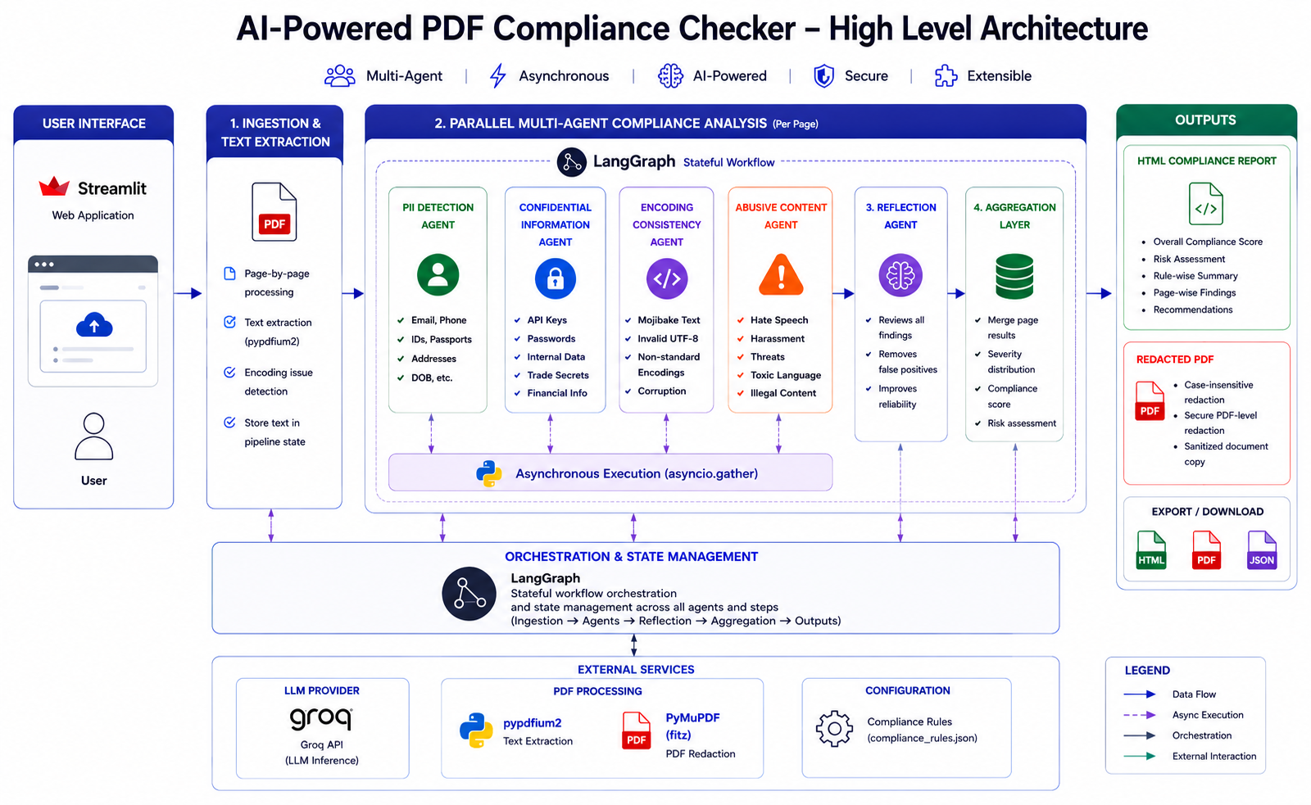

Slide 5
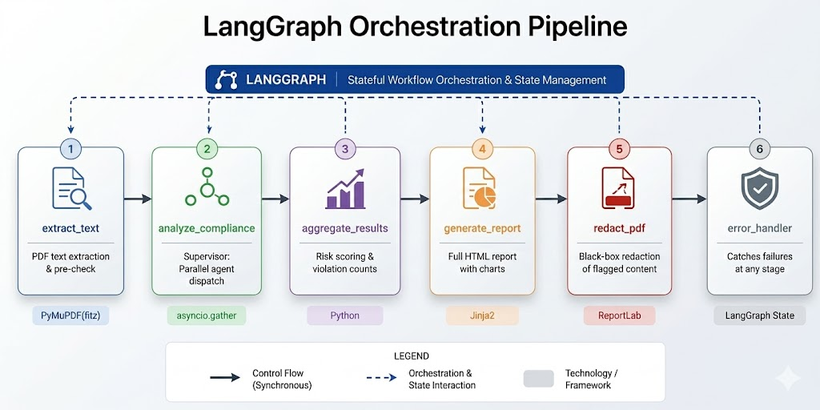
LangGraph Orchestration Pipeline

Slide 6
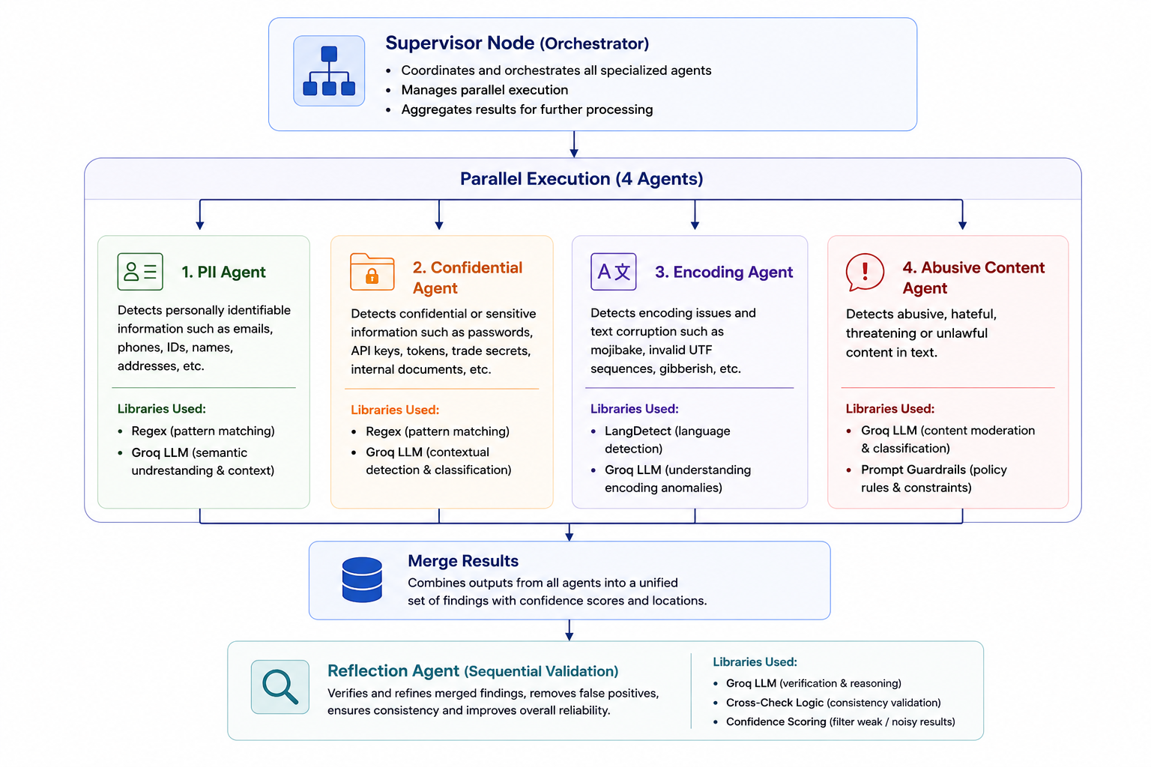
Multi-Agent Compliance Architecture

Slide 7
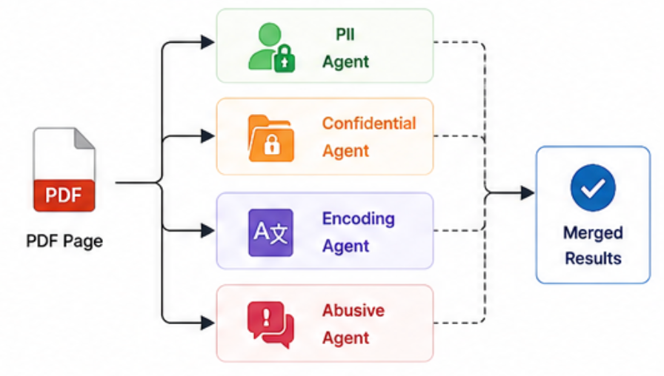
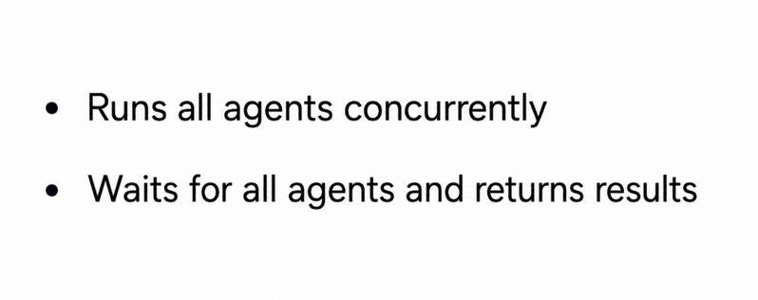
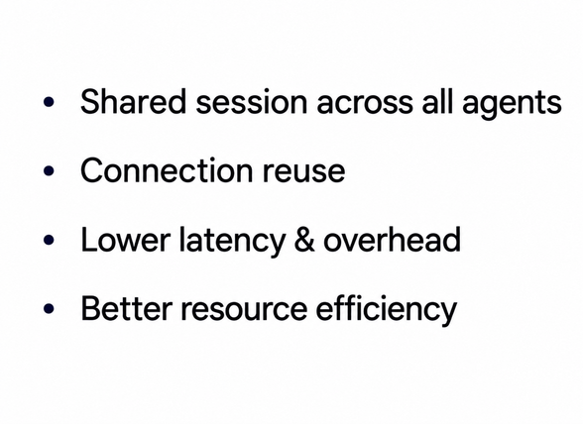
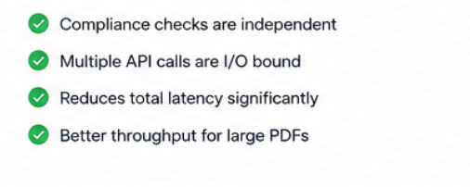

Asynchronous Parallel Execution
asyncio.gather()
aiohttp.ClientSession()
What parallel execution giving us

Slide 8
Engineering the Prompts
Technique | Where Used | Purpose
Role-based Prompt | All agents | Enforces expert persona
Few-shot Examples | Compliance agents | Guidance on edge cases
Chain-of-Thought | All agents | Explainable reasoning
Negative Constraints | PII / Abusive | Prevents over-flagging
Injection Guard | System prompt | Blocks adversarial input
Conservative Bias | Reflection Agent | Ensures data safety
Hybrid (Regex + LLM) | PII Agent | Regex answers it in microseconds with 100% consistency

Slide 9
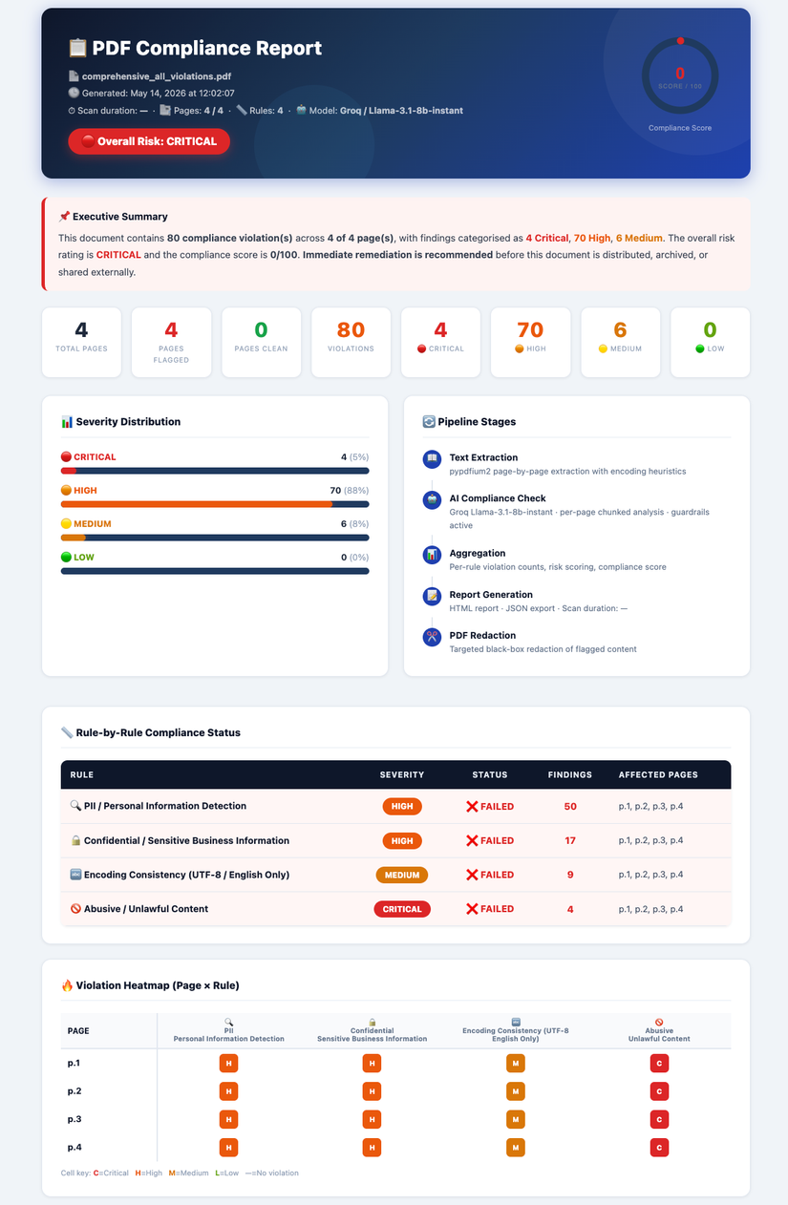

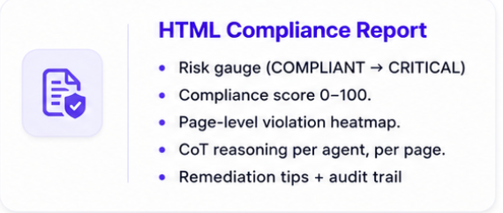
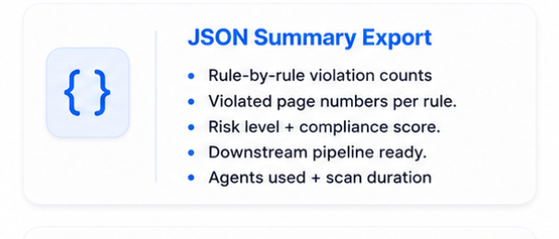
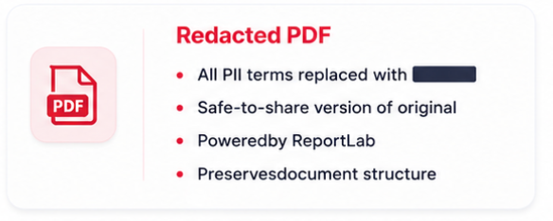
System Outputs & Reports
HTML Compliance Report
Risk gauge (COMPLIANT → CRITICAL)Compliance score 0–100. Page-level violation heatmap.CoT reasoning per agent, per page.Remediation tips + audit trail
JSON Summary Export
Rule-by-rule violation countsViolated page numbers per rule.Risk level + compliance score.Downstream pipeline ready.Agents used + scan duration
Redacted PDF
All PII terms replaced with ████Safe-to-share version of originalPoweredby ReportLabPreservesdocument structure

Slide 10
Time and Cost Estimates
Estimated Time and Cost Saved
Tokens used
Measured benchmark (actual run)
4 pages ·
avg 15 lines/page · 25 sec total.
Per-page scan time: 7 seconds. Includes: extract → 4 parallel agents → reflect → aggregate → report
Manual review assumptions
Compliance analyst rate: $45 / hour .
Manual time per page: ~8 min (4 rules × 2 min each)
Parallel Supervisor
Total tokens (4 pages) = 29,484
Per page = $0.0046
Per 50-page doc = $0.228
Annual API cost = $118.64
Sequential
Total tokens (4 pages) = 26,256
Per page = $0.0046
Per 50-page doc = $0.206
Annual API cost = $106.91
7 sec
per page (measured)
4 pages in 25 sec actual
$296
saved per document
at $45/hr analyst rate
TradeOff
Reasoning that hedges between rules ("this could be PII or confidential")
Longer, more uncertain output to compensate
Higher false positive rate → more ReflectionAgent work
One JSON blob for 4 rules → harder to parse, harder to audit
6.6 hrs
saved per 50-page doc
vs 8 min manual/page
$153K+
annual saving
at 10 docs/week

Slide 11

Thank You
GitHub: github.com/Rekha-Kumre17/pdf-compliance-check

